Slide 1
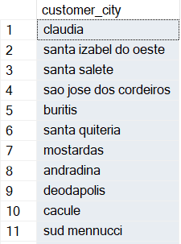
BASIC PROBLEMS
SQL OUTPUT
Q1.List all unique cities where Customers are located.
SELECT DISTINCT customer_city
FROM customers$;

Slide 2
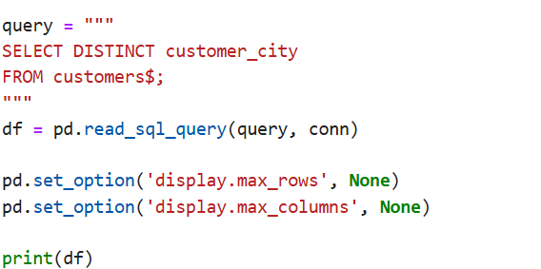
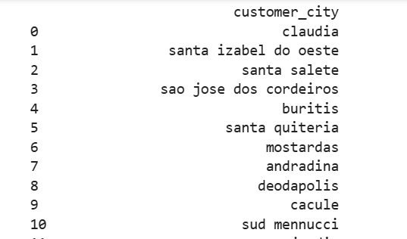
BASIC PROBLEMS
PYTHON OUTPUT
Q1.List all unique cities where Customers are located.

Slide 3

BASIC PROBLEMS
SQL OUTPUT
Q2--Count the number of orders placed in 2017
SELECT COUNT(*) AS total_orders_2017
FROM orders$
WHERE YEAR(order_purchase_timestamp) = 2017;

Slide 4
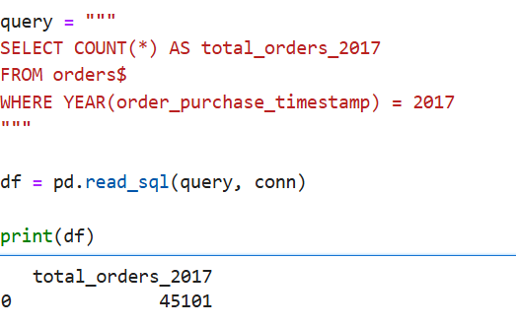
BASIC PROBLEMS
PYTHON OUTPUT
Q2--Count the number of orders placed in 2017

Slide 5
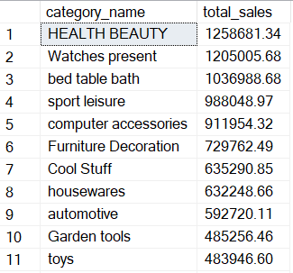
BASIC PROBLEMS
SQL OUTPUT
Q3--Find the total sales per Categary
SELECT
p.[product category] AS category_name,
SUM(oi.price) AS total_sales
FROM dbo.order_items$ oi
JOIN dbo.products$ p
ON oi.product_id = p.product_id
GROUP BY p.[product category]
ORDER BY total_sales DESC;

Slide 6
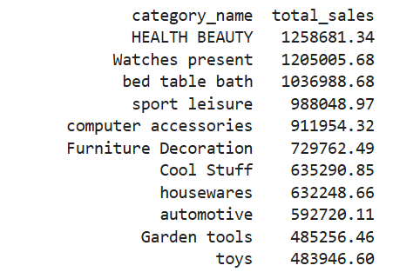
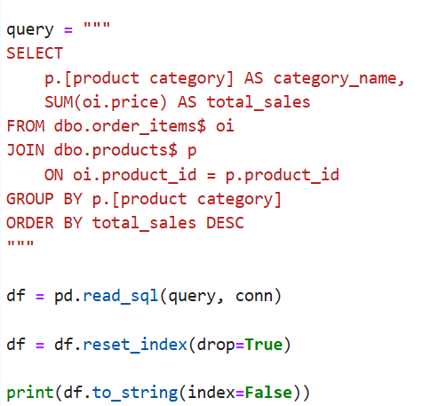
BASIC PROBLEMS
PYTHON OUTPUT
Q3--Find the total sales per Category

Slide 7

BASIC PROBLEMS
SQL OUTPUT
Q4 --Calculate the percentage of orders that were paid in Installments
SELECT
(SUM(CASE WHEN payment_installments > 1 THEN 1 ELSE 0 END) * 100.0
/ COUNT(*)) AS installment_percentage
FROM payments$;

Slide 8
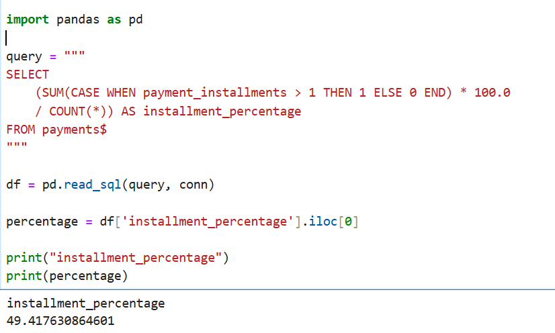
BASIC PROBLEMS
PYTHON OUTPUT
Q4 --Calculate the percentage of orders that were paid in Installments

Slide 9
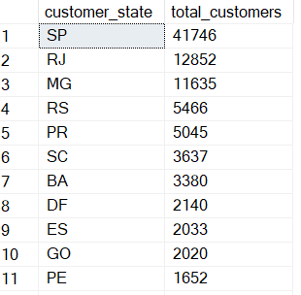
BASIC PROBLEMS
SQL OUTPUT
Q5. Count the number of customers from each state.
SELECT
customer_state,
COUNT(customer_id) AS total_customers
FROM customers$
GROUP BY customer_state
ORDER BY total_customers DESC;

Slide 10
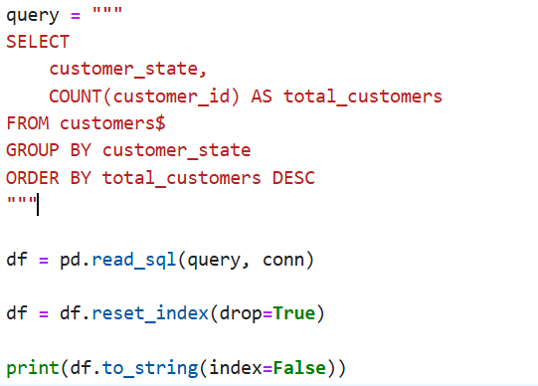
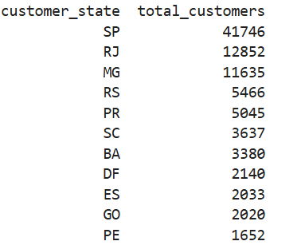
I PROBLEMS
SQL OUTPUT
Q5. Count the number of customers from each state.

Slide 11
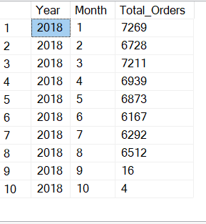
INTERMEDIATE PROBLEMS
SQL OUTPUT
Q1.Calculate the number of orders per month in 2018.
SELECT
YEAR(order_purchase_timestamp) AS Year,
MONTH(order_purchase_timestamp) AS Month,
COUNT(order_id) AS Total_Orders
FROM orders$
WHERE order_purchase_timestamp >= '2018-01-01'
AND order_purchase_timestamp < '2019-01-01'
GROUP BY
YEAR(order_purchase_timestamp),
MONTH(order_purchase_timestamp)
ORDER BY Year, Month;

Slide 12
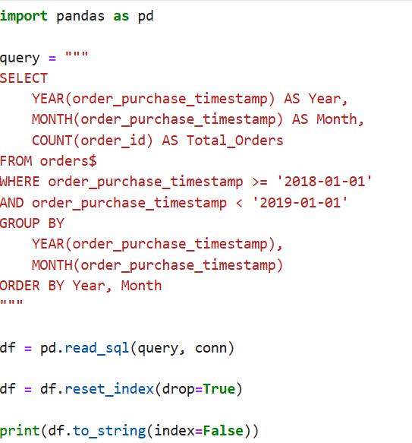
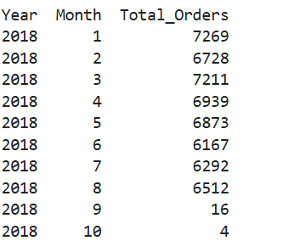
INTERMEDIATE PROBLEMS
PYTHON OUTPUT
Q1.Calculate the number of orders per month in 2018.

Slide 13
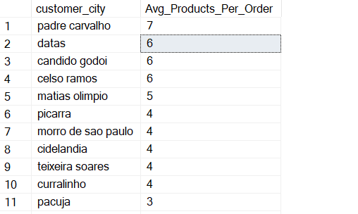
INTERMEDIATE PROBLEMS
SQL OUTPUT
Q2 Find the average number of products per order, grouped by customer city.
SELECT
c.customer_city,
AVG(Product_Count) AS Avg_Products_Per_Order
FROM
(
SELECT
o.order_id,
o.customer_id,
COUNT(oi.product_id) AS Product_Count
FROM orders$ o
JOIN order_items$ oi
ON o.order_id = oi.order_id
GROUP BY
o.order_id,
o.customer_id
) AS OrderProductCount
JOIN customers$ c
ON OrderProductCount.customer_id = c.customer_id
GROUP BY c.customer_city
ORDER BY Avg_Products_Per_Order DESC;

Slide 14
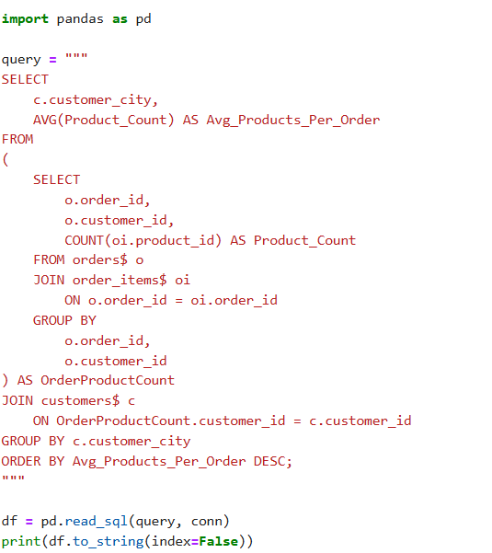
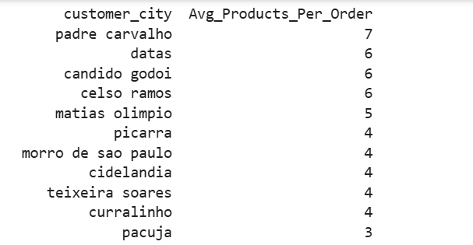
INTERMEDIATE PROBLEMS
SQL OUTPUT
Q2 Find the average number of products per order, grouped by customer city.

Slide 15
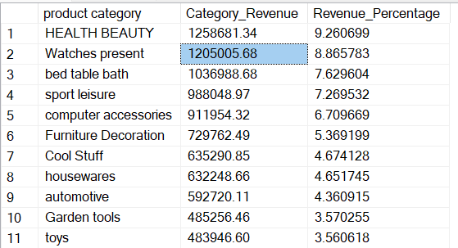
INTERMEDIATE PROBLEMS
SQL OUTPUT
Q3. Calculate the percentage of total revenue contributed by each product category.
SELECT
p.[product category],
SUM(oi.price) AS Category_Revenue,
SUM(oi.price) * 100.0 /
(SELECT SUM(price) FROM order_items$)
AS Revenue_Percentage
FROM order_items$ oi
JOIN products$ p
ON oi.product_id = p.product_id
GROUP BY p.[product category]
ORDER BY Revenue_Percentage DESC;

Slide 16
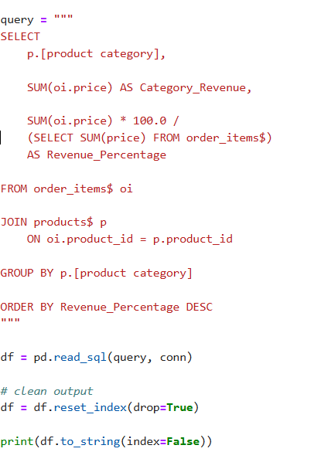
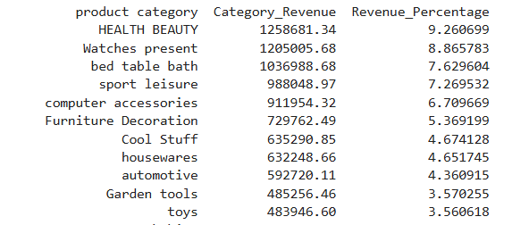
INTERMEDIATE PROBLEMS
PYTHON OUTPUT
Q3. Calculate the percentage of total revenue contributed by each product category.

Slide 17
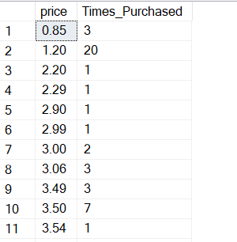
INTERMEDIATE PROBLEMS
PYTHON OUTPUT
Q4. Identify the correlation between product price and the number of times a product has been purchased.
SELECT
price,
COUNT(product_id) AS Times_Purchased
FROM order_items$
GROUP BY price
ORDER BY price;

Slide 18
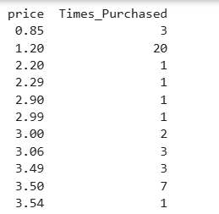
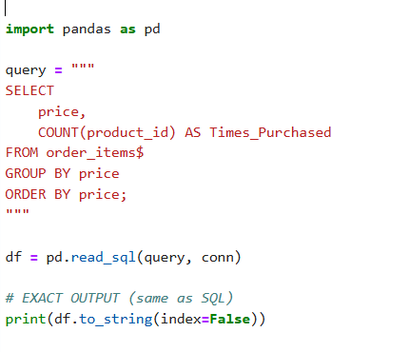
INTERMEDIATE PROBLEMS
PYTHON OUTPUT
Q4. Identify the correlation between product price and the number of times a product has been purchased.

Slide 19
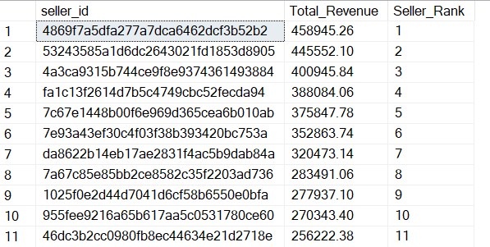
INTERMEDIATE PROBLEMS
SQL OUTPUT
Q5. Calculate the total revenue generated by each seller, and rank them by revenue
SELECT
s.seller_id,
SUM(oi.price) AS Total_Revenue,
RANK() OVER
(ORDER BY SUM(oi.price) DESC) AS Seller_Rank
FROM order_items$ oi
JOIN sellers$ s
ON oi.seller_id = s.seller_id
GROUP BY s.seller_id
ORDER BY Seller_Rank;

Slide 20
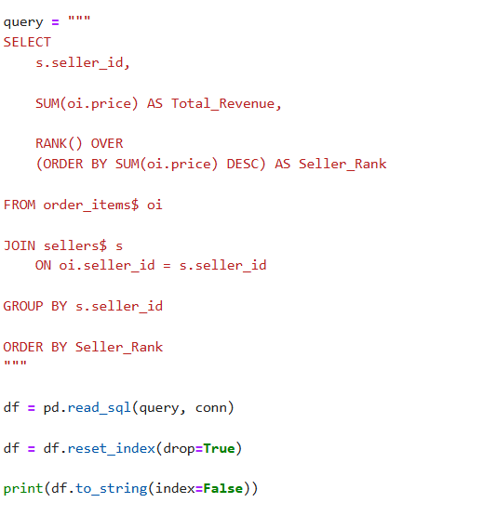
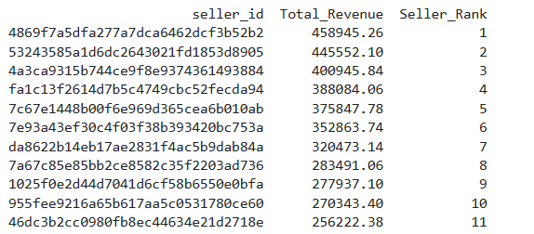
INTERMEDIATE PROBLEMS
PYTHON OUTPUT
Q5. Calculate the total revenue generated by each seller, and rank them by revenue

Slide 21
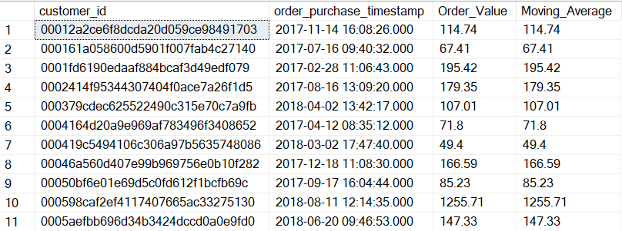
ADVANCED PROBLEMS
SQL OUTPUT
Q1.Calculate the moving average of order values for each customer over their order history.
SELECT
o.customer_id,
o.order_purchase_timestamp,
SUM(p.payment_value) AS Order_Value,
AVG(SUM(p.payment_value)) OVER
(
PARTITION BY o.customer_id
ORDER BY o.order_purchase_timestamp
) AS Moving_Average
FROM dbo.orders$ o
JOIN dbo.payments$ p
ON o.order_id = p.order_id
GROUP BY
o.customer_id,
o.order_purchase_timestamp
ORDER BY
o.customer_id,
o.order_purchase_timestamp;

Slide 22
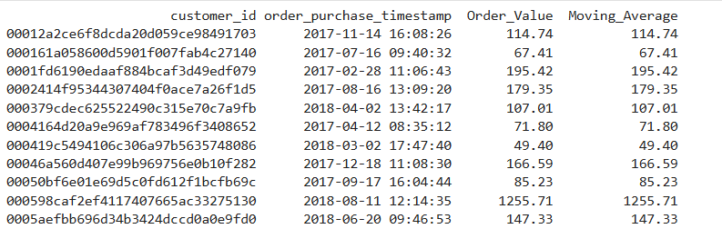
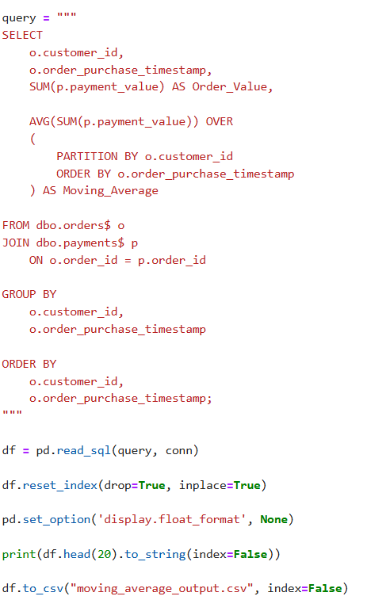
ADVANCED PROBLEMS
SQL OUTPUT
Q1.Calculate the moving average of order values for each customer over their order history.

Slide 23
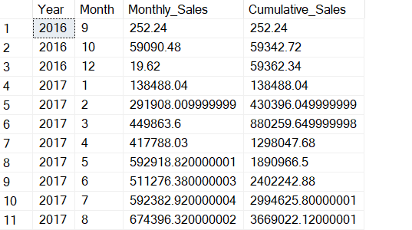
ADVANCED PROBLEMS
SQL OUTPUT
Q2.Calculate the cumulative sales per month for each year
SELECT
YEAR(o.order_purchase_timestamp) AS Year,
MONTH(o.order_purchase_timestamp) AS Month,
-- Monthly sales
SUM(p.payment_value) AS Monthly_Sales,
-- Cumulative sales
SUM(SUM(p.payment_value)) OVER
(
PARTITION BY YEAR(o.order_purchase_timestamp)
ORDER BY MONTH(o.order_purchase_timestamp)
) AS Cumulative_Sales
FROM dbo.orders$ o
JOIN dbo.payments$ p
ON o.order_id = p.order_id
GROUP BY
YEAR(o.order_purchase_timestamp),
MONTH(o.order_purchase_timestamp)
ORDER BY Year, Month;

Slide 24
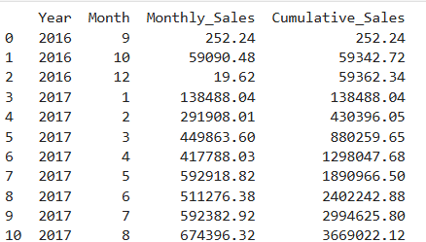
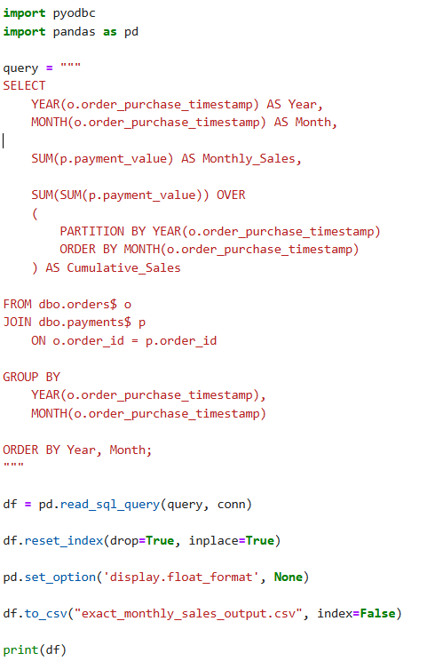
ADVANCED PROBLEMS
PYTHON OUTPUT
Q2.Calculate the cumulative sales per month for each year

Slide 25
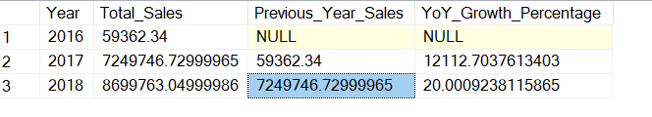
ADVANCED PROBLEMS
SQL OUTPUT
Q3.Calculate the year-over-year growth rate of total sales.
SELECT
YEAR(o.order_purchase_timestamp) AS Year,
SUM(p.payment_value) AS Total_Sales,
LAG(SUM(p.payment_value)) OVER
(
ORDER BY YEAR(o.order_purchase_timestamp)
) AS Previous_Year_Sales,
(
SUM(p.payment_value)
- LAG(SUM(p.payment_value)) OVER
(ORDER BY YEAR(o.order_purchase_timestamp))
) * 100.0
/
LAG(SUM(p.payment_value)) OVER
(ORDER BY YEAR(o.order_purchase_timestamp))
AS YoY_Growth_Percentage
FROM dbo.orders$ o
JOIN dbo.payments$ p
ON o.order_id = p.order_id
GROUP BY YEAR(o.order_purchase_timestamp)
ORDER BY Year;

Slide 26
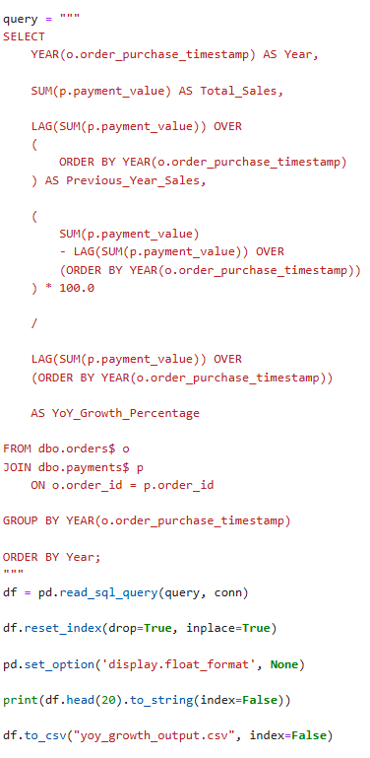

ADVANCED PROBLEMS
SQL OUTPUT
Q3.Calculate the year-over-year growth rate of total sales.

Slide 27
ADVANCED PROBLEMS
SQL OUTPUT
Q4-Calculate the retention rate of customers, defined as the percentage of customers
who make another purchase within 6 months of their first purchase.
WITH FirstPurchase AS
(
SELECT
customer_id,
MIN(order_purchase_timestamp) AS first_purchase_date
FROM dbo.orders$
GROUP BY customer_id
),
NextPurchase AS
(
SELECT
fp.customer_id,
fp.first_purchase_date,
MIN(o.order_purchase_timestamp) AS next_purchase_date
FROM FirstPurchase fp
JOIN dbo.orders$ o
ON fp.customer_id = o.customer_id
AND o.order_purchase_timestamp > fp.first_purchase_date
GROUP BY
fp.customer_id,
fp.first_purchase_date
)
SELECT
COUNT(customer_id) * 100.0 /
(
SELECT COUNT(*) FROM FirstPurchase
)
AS Retention_Rate_Percentage
FROM NextPurchase
WHERE DATEDIFF(MONTH, first_purchase_date, next_purchase_date) <= 6;

Slide 28
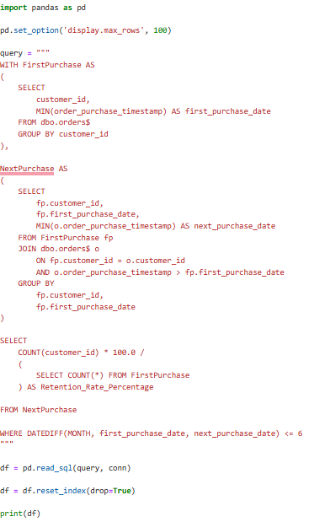
ADVANCED PROBLEMS
PYTHON OUTPUT
Q4-Calculate the retention rate of customers, defined as the percentage of customers
who make another purchase within 6 months of their first purchase.

Slide 29
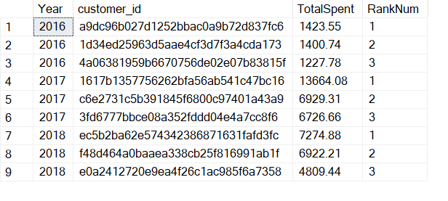
ADVANCED PROBLEMS
SQL OUTPUT
Q5.Identify the top 3 customers who spent the most money in each year.
WITH CustomerYearSales AS
(
SELECT
YEAR(o.order_purchase_timestamp) AS Year,
o.customer_id,
SUM(p.payment_value) AS TotalSpent
FROM dbo.orders$ o
JOIN dbo.payments$ p
ON o.order_id = p.order_id
GROUP BY
YEAR(o.order_purchase_timestamp),
o.customer_id
),
RankedCustomers AS
(
SELECT *,
RANK() OVER
(
PARTITION BY Year
ORDER BY TotalSpent DESC
) AS RankNum
FROM CustomerYearSales
)
SELECT
Year,
customer_id,
TotalSpent,
RankNum
FROM RankedCustomers
WHERE RankNum <= 3
ORDER BY Year, RankNum;

Slide 30
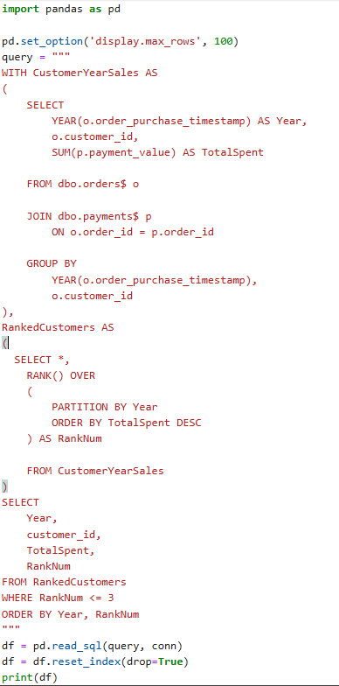
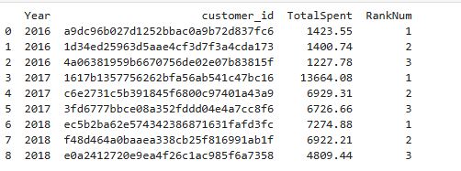
ADVANCED PROBLEMS
PYTHON OUTPUT
Q5.Identify the top 3 customers who spent the most money in each year.

